Slide 1

TOPIC:
Computer Organization and Architecture
Addressing Modes
(Lectures 23-25)
By-
Dr. Bineet Kaur (Asst. Prof., DICE)

Slide 2
Addressing Modes

Slide 3
Addressing Mode
The operation field of an instruction specifies the operation to be performed.
This operation must be executed on some data stored in computer registers or memory words.
The way the operands are chosen during program execution is dependent on the addressing mode of the instruction.
The addressing mode specifies a rule for interpreting or modifying the address field of the instruction before the operand is actually referenced.
Computers use addressing mode techniques for the purpose of accommodating one or both of the following provisions:
To give programming versatility to the user by providing such facilities as pointers to memory, counters for loop control, indexing of data, and program relocation.
To reduce the number of bits in the addressing field of the instruction

Slide 4
Implied Mode
The operands are specified implicitly in the definition of the instruction.
Eg: CMA - Complement Accumulator.
All register reference instructions that use an accumulator are implied-mode instructions.
Zero-address instructions in a stack-organized computer are implied-mode instructions since the operands are implied to be on top of the stack.

Slide 5
Immediate Mode
The operand is specified in the instruction itself.
It has an operand field rather than an address field.
The operand field contains the actual operand to be used in conjunction with the operation specified in the instruction.
They are useful for initializing registers to a constant value.
Eg: ADD 7

Slide 6
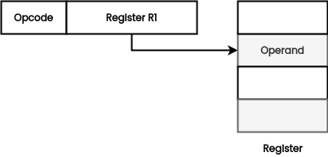
Register Mode
The address field specifies a processor register.
In this mode the operands are in registers that reside within the CPU.
The particular register is selected from a register field in the instruction.
A k-bit field can specify any one of 2k registers.
Eg: ADD R1

Slide 7
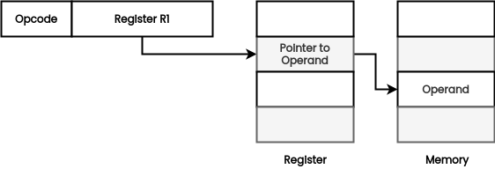
Register Indirect Mode
The instruction specifies a register in the CPU whose contents give the address of the operand in memory.
The selected register contains the address of the operand rather than the operand itself.
Before using a register indirect mode instruction, the programmer must ensure that the memory address of the operand is placed in the processor register with a previous instruction.
Advantage - The address field of the instruction uses fewer bits to select a register.

Slide 8
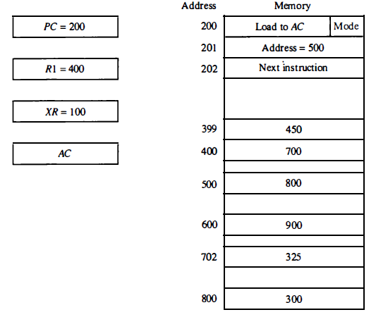
Auto-increment and Auto-decrement
In case of auto-increment, the effective address is 400 with operand 700. After this it would be incremented to 401.
In case of auto-decrement, the effective address is 399 and operand is 450.

Slide 9
Direct and Indirect Address Mode
In case of direct addressing, the effective address is 500 with operand 800.
In case of indirect addressing, the effective address is 800 and operand is 300.

Slide 10
Relative Mode
Content of the program counter is added to the address part of the instruction in order to obtain the effective address.
This number is added to the content of the program counter, producing an effective address whose position in memory is relative to the address of the next instruction.
Example: PC contains the number 201 The address part of the instruction contains the number 500. The instruction at location 201 is read from memory during the fetch phase and the program counter is then incremented by one to 202. The effective address computation for the relative address mode is 202+ 500= 702 and operand is 325.

Slide 11
Indexed Addressing
Content of an index register is added to the address part of the instruction to obtain the effective address.
The index register is a special CPU register that contains an index value.
The address field of the instruction defines the beginning address of a data array in memory.
The distance between the beginning address and the address of the operand is the index value stored in the index register.
The index register XR=100 which gets added with address=500 i.e. effective address is 100+500=600 and operand is 900.

Slide 12
Thank You

